Slide 1
Successful Implementation of eProcurement system at
Mahanadi Coalfields Ltd
S K BHANJA
GM(SYSTEMS/E-PROCUREMENT)
MAHANADI COALFIELDS LTD
e-Mail : hod-eproc.mcl@coalindia.in

Slide 2
HAPPY NEW YEAR
Wishing you all a very
MAY THIS YEAR BE ESPECIALLY BRIGHT
YOUR GOALS IN LIFE BE WELL IN SIGHT
YOUR PROBLEMS FEW AND WORRIES LESS
WITH GOOD HEALTH AND HAPPIENESS
2
0
1
8

Slide 3
INDEX
Brief about Mahanadi Coalfields Ltd & Coal India Ltd
Scenario prior to implementation of e-Procurement
Preparation for implementation
Challenges addressed
Special features of CIL e-Procurement process
Impacts of e-Procurement
Reverse Auction
Trends in e-Procurement
Awards and recognitions
Conclusion

Slide 4
Mahanadi Coalfields Ltd
A Brief introduction
Mahanadi Coalfields Ltd is one of the nine subsidiary companies of Coal India Ltd, which is a Maha Ratna PSU and largest Coal Producing company of the world.
MCL is the first PSU to avail the e-Procurement Services of NIC way back in 2009
MCL e-Procurement portal(https://mcltenders.nic.in) was shifted and merged with the portal of its parent organization Coal India e-Procurement portal URL > https://coalindiatenders.nic.in w.e.f 01.01.2017
MCL publishes approximately 2500 tenders per year valuing Rs 2500- 3000 crores per year
It has 25 Coal mines spread across the state of Orissa
Manpower -22000 (approx.)
Profit before Taxes – Rs 6000 Crores( Approx)
Production of Coal – 139 Million Tonnes last year

Slide 5
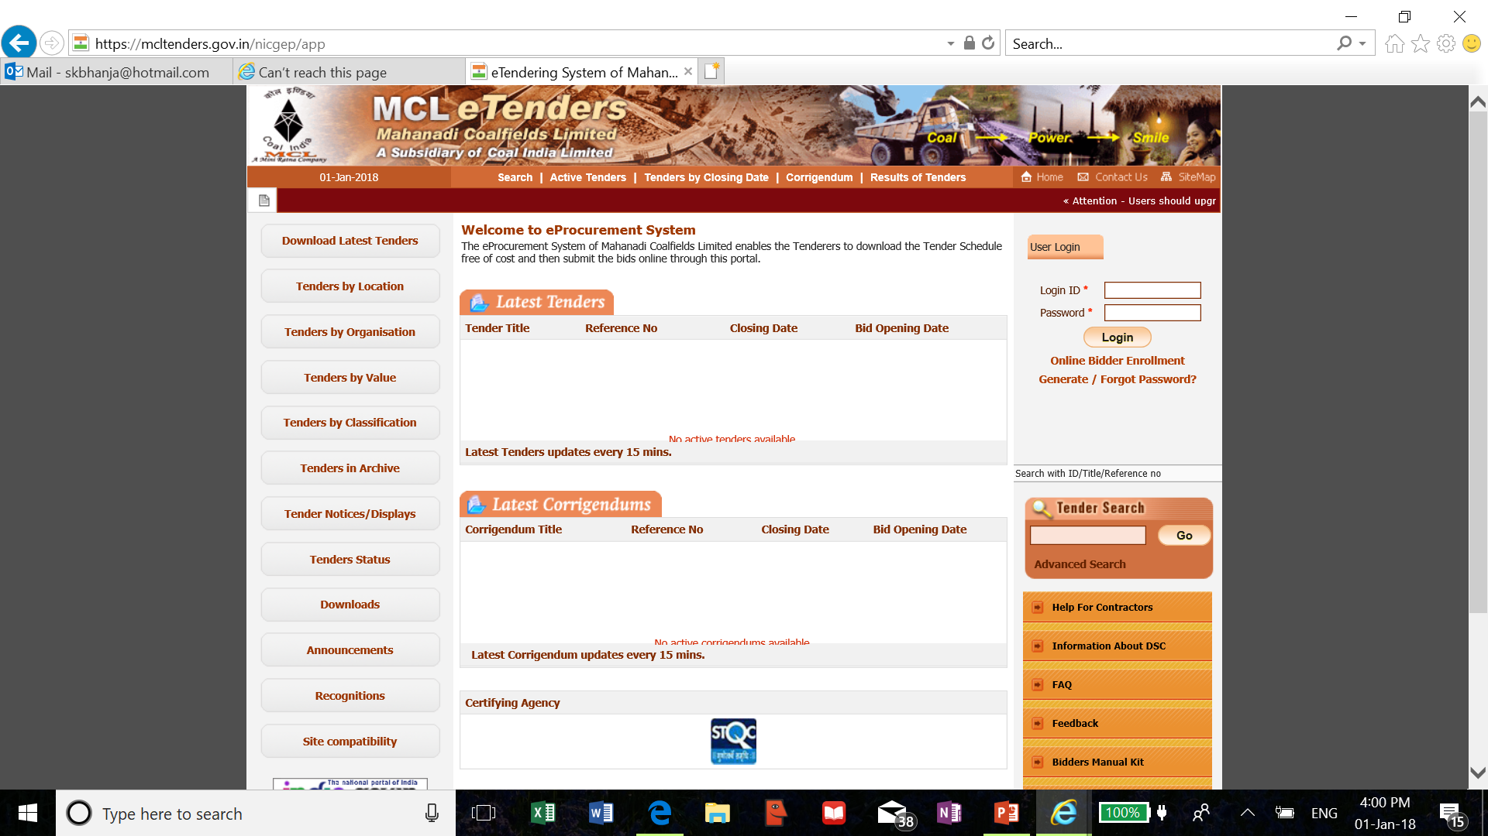
Old MCL e-Procurement portal

Slide 6
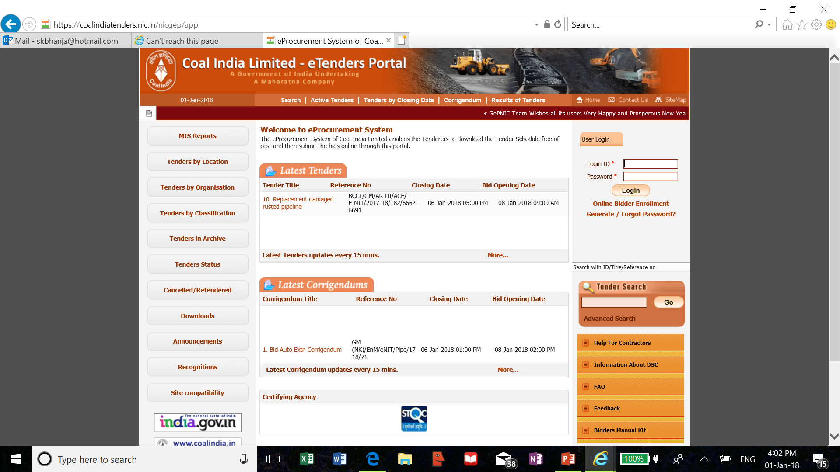
Present Coal India e-Procurement Portal

Slide 7
Scenario prior to implementation of e-Procurement
Very long cycle time for finalization of tender
Lot of manual efforts
Inconsistent subjective decisions
Complaints and litigations
Lack of transparency
Wastage of time in communication
Huge effort and cost involved in Bid preparation and submission
Huge RTI queries relating to Tenders

Slide 8
Preparation for implementation
Action for implementation started during 2008/2009.
As-is study of the Procurement system
Re-engineering the Procurement process with help of M/s Ernst & Young
Creation of Infrastructure [Internet connection, Digital Signature Certificate Computer, Printer, Scanner, Anti-virus etc]
Framing of Process Document /Manual
Steering committee consisting of Domain experts/Users
Standard Bid Document for all categories of Tenders
Created a multi-disciplinary department to look after eProcurement activities

Slide 9
Challenges addressed
Training to prospective Bidders spread over the country and beyond
  Bidders Manual Kit, YouTube video, Class Room training, Web-based Training
Extensive Training to Departmental Users
Building a support infrastructure
Identifying the information to be captured from Bidders
Framing the Business Logic for auto-evaluation of bids
Framing the comprehensive e-Procurement Guideline/Manual before launch of Live site
Selection of a Techno-economically viable solution and a reliable Service Provider
Buy-in by the Process owners(Tender Inviting Depts)
Earning confidence and support of top management
Process integration with Nodal Bank for EMD Management

Slide 10
Special features of CIL e-Procurement process
Information based auto-evaluation system vis-à-vis Document based evaluation
Verification of only L1 Bidder’s bid document(Only in case of Procurement of sophisticated equipment all the bid documents are examined)
Penal provisions for Bidders if failed to produce documents in support of information uploaded
Automated EMD receipt, refund and resettlement of EMD
Standardized Bid Documents, General Technical Evaluation templates, Technical Parameter Sheet and Bill of Quantity templates
Managing Bidders’ clarifications
Managing complicated multi-currency Global tenders

Slide 11
Impacts of e-Procurement
Drastic reduction of cycle time for finalization of tenders from 120 to 69 days
On an average about 15-16% saving has been achieved
Unethical Business practices greatly reduced
Human efforts and errors are minimized
Subjective judgement is eliminated
Complaints and litigations have reduced
Facilitates analysis of data for better decision making
Reduction in cost of publication in Print media
With the advent of CPP publicity of Tenders has reached new heights
Better bidder base leading to better competition and better price discovery

Slide 12
Impacts of e-Procurement
Contd..
Convenience to Bidders
  Instant validation of bid information and feedback message
  System generated SMS/e-mail at appropriate stages
  Auto-refund of EMD within 24 hours
  Facility to seek clarifications without disclosing identity of bidders
  Reverse Auction process allows the bidder to revise the price any number of times
  Convenient to search and bid in the tenders
  Bid acknowledgement with status of compliance

Slide 13
Reverse Auction(RA)
RA is one of the best Pricing Tools for better Price discovery, but may not be suitable for all types of Tenders.
Secrecy of the biding is very important to avoid cartel formation
Due to competition by adopting RA savings to the tune of 10-15% is possible.
RA may be adopted for those Tenders where there is less scope of compromising with Quality (for example Loading of Coal in Rail Wagons, Transportation of Coal, Production of Coal, Supply of BIS marked products etc)
RA could be before opening of Price Bids or after opening of Price Bid

Slide 14
Reverse Auction
Before vis-a-vis after Price Bid disclosure
RA before opening of Price Bids
  Bit difficult to decide the Start Bid Price and can be left open to the first Bid
  Lowest of the Price Bid or RA is considered.
  Both the RA and Price Bid complement each other for better Price Discovery
  Organizations where document based evaluation system is prevalent, this mode should be more effective
RA- After opening of Price Bids
  Easy to decide start Bid Price, normally based on the L1 price or Estimated Price or a combination of both based on some logic
  Bidder is aware of the lowest price and may win or loose the tender with full knowledge
  A factor of uncertainty is required for getting a competitive price in the Price Bid
    H1 elimination
    RA to be resorted only if number of bids are more than three
    Three lowest bidders will be allowed to bid in RA

Slide 15
Reverse Auction – Case study
Reverse Auction before opening of Price Bid
Start Bid Price – Rs 1000 Crore
Minimum Decrement Value – Rs 10 crore
Four Bidders – A, B, C, D
  No bid placed for sometime
  A > 990 Cr
  A > 980 Cr
  A > 970 Cr
  A > 960 Cr
Original Quoted Price > A : 980 B : 1200 C : 1320 D : 1210
Bidder A thought that other bidders might have quoted less than the Auction Price, hence they are not participating in RA.

Slide 16
Trends in e-Procurement
Information based tender evaluation system
Automated EMD Management(Receipt, Refund & Settlement)
Reverse Auction maintaining secrecy of bids
Bidding on Total Cost of Ownership
Post-award contract management
Central Vendor rating
Integration with ERP system
Analysis of Tender Data for Management Decision Support

Slide 17
Awards & Recognitions
  Best project under Citizen's Choice in Government to Business(G2B) Category in e-India 2010.
  Best Project award by Confederation of Indian Industry(CII) in 2011
  Selected for Best project under Citizen's Choice in Government to Business Category in e-World 2011.
  Coal India Awards as Best Innovative initiative
  Best G2B Initiative Award in e-Odisha 2014 forum
  Awards from Institute of Public Enterprise & Vigilance Study Circle

Slide 18

Special Thanks to :
NATIONAL
INFORMATICS
CENTRE
For making our dreams, transformed into reality
Congratulations on completing a decade of successful implementation

Slide 19


